Slide 1
Magenic Masters React Environment Setup
Jan 19, 2017
Tim Chan

Slide 2
Agenda
Setup Walkthrough
Development Tools
Node.js and NPM
Webpack
Babel

Slide 3
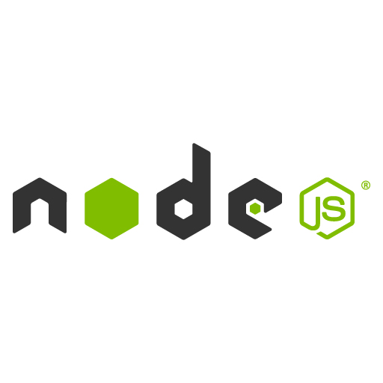
What is Node.js?
Open-source, cross-platform Javascript runtime environment

Slide 4
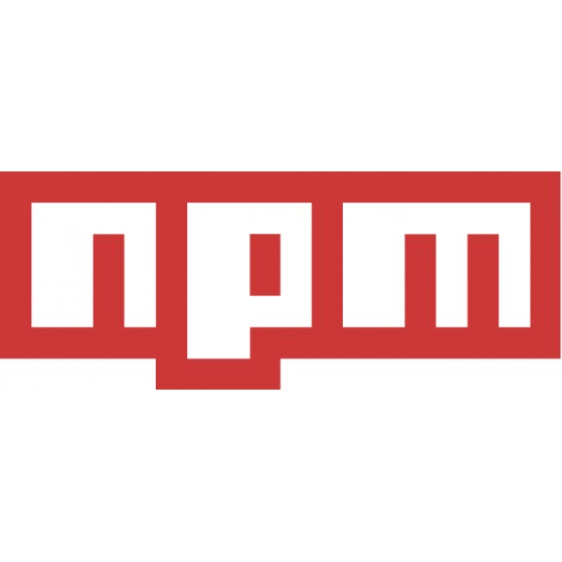
What is NPM?
default package manager for Node.js
makes it easy for developers to reuse codes, share codes, manage different version of codes
package - any directory with one or more files with a package.json
Notes:
Check version: npm -v
Install latest npm: npm install npm@latest –g
A package.json file affords you a lot of great things:
It serves as documentation for what packages your project depends on.
It allows you to specify the versions of a package that your project can use using semantic versioning rules.
Makes your build reproducable which means that its way easier to share with other developers.
npm init
"dependencies": these packages are required by your application in production
"devDependencies": these packages are only needed for development and testing
To add an entry to your package.json's dependencies:
npm install <package_name> --save
To add an entry to your package.json's devDependencies:
npm install <package_name> --save-dev

Slide 5
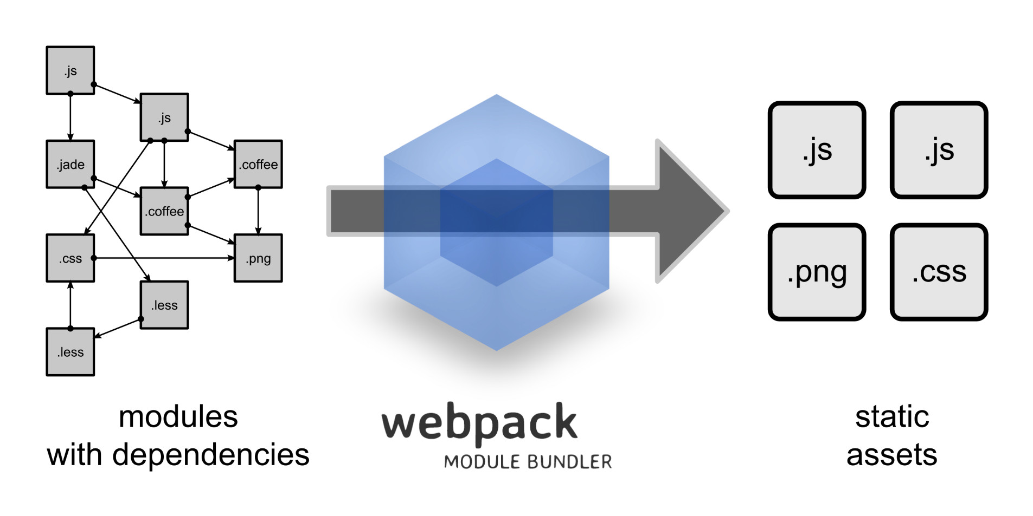
What is webpack?
code splitting, loaders, clever parsing, plugin system
Notes:
Code Splitting
webpack has two types of dependencies in its dependency tree: sync and async. Async dependencies act as split points and form a new chunk. After the chunk tree is optimized, a file is emitted for each chunk.
For big web apps it’s not efficient to put all code into a single file, especially if some blocks of code are only required under some circumstances. Webpack has a feature to split your codebase into “chunks” which are loaded on demand. Some other bundlers call them “layers”, “rollups”, or “fragments”. This feature is called “code splitting”.
It’s an opt-in feature. You can define split points in your code base. Webpack takes care of the dependencies, output files and runtime stuff.
To clarify a common misunderstanding: Code Splitting is not just about extracting common code into a shared chunk. The more notable feature is that Code Splitting can be used to split code into an on demand loaded chunk. This can keep the initial download small and downloads code on demand when requested by the application.
Loaders
webpack can only process JavaScript natively, but loaders are used to transform other resources into JavaScript. By doing so, every resource forms a module.
Read more about Using loaders and Loaders.
Clever parsing
webpack has a clever parser that can process nearly every 3rd party library. It even allows expressions in dependencies such as: require("./templates/" + name + ".jade"). It handles the most common module styles: CommonJs and AMD.
Read more about expressions in dependencies, CommonJs and AMD.
Plugin system
webpack features a rich plugin system. Most internal features are based on this plugin system. This allows you to customize webpack for your needs and distribute common plugins as open source.

Slide 6
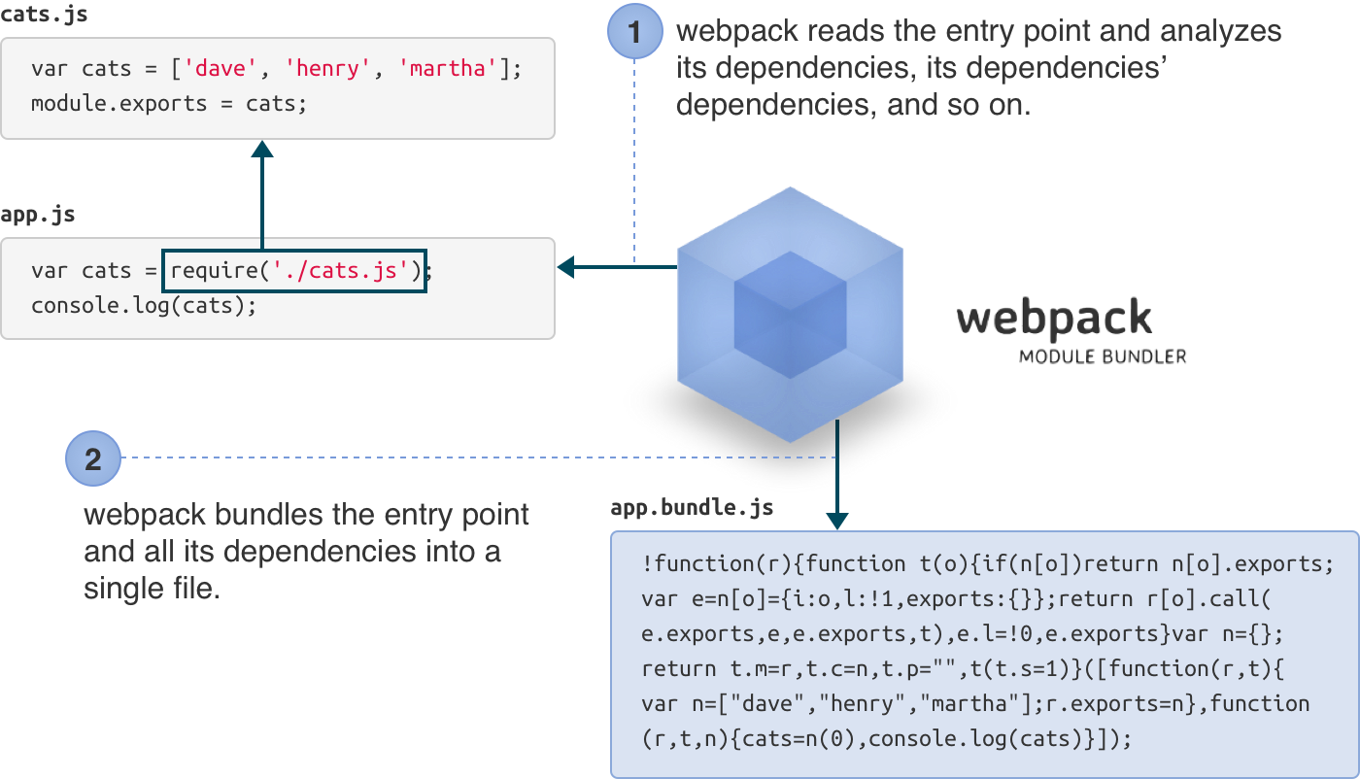
Webpack in 5 seconds

Slide 7
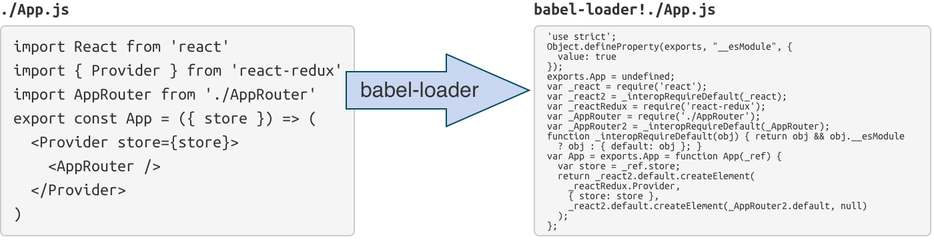
Webpack loaders
special modules webpack uses to ‘load’ other modules (written in another language) into JavaScript (that webpack understands)

Slide 8
Webpack-dev-server
Ready to use solution that serves webpack bundle (using webpack-dev-middleware)

Slide 9
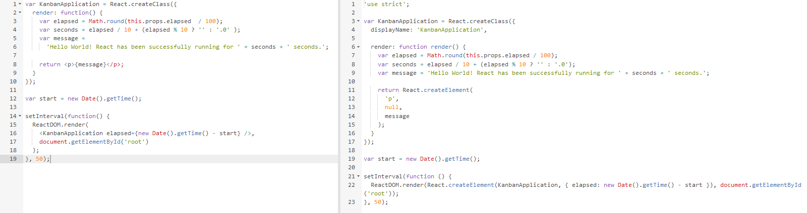
What is babel?
Transforms your JavaScript

Slide 10
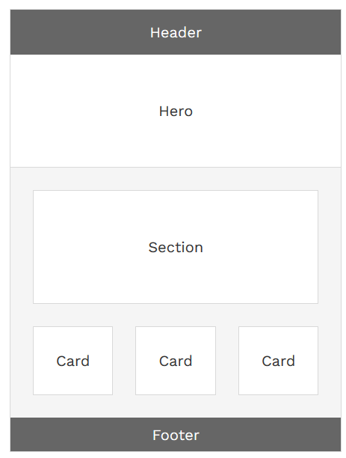
Assignment
Setup Development Environment
Add bootstrap
Create the following layout (think components)
Bonus 1 point to final grade – split components in several files, include bootstrap in webpack bundle, use react-bootstrap library

